Slide 1


10 tips to up your Power BI Game in 20 Minutes
Ashley Warren
Senior Analytics Consultant @
Advancing Analytics

Slide 2
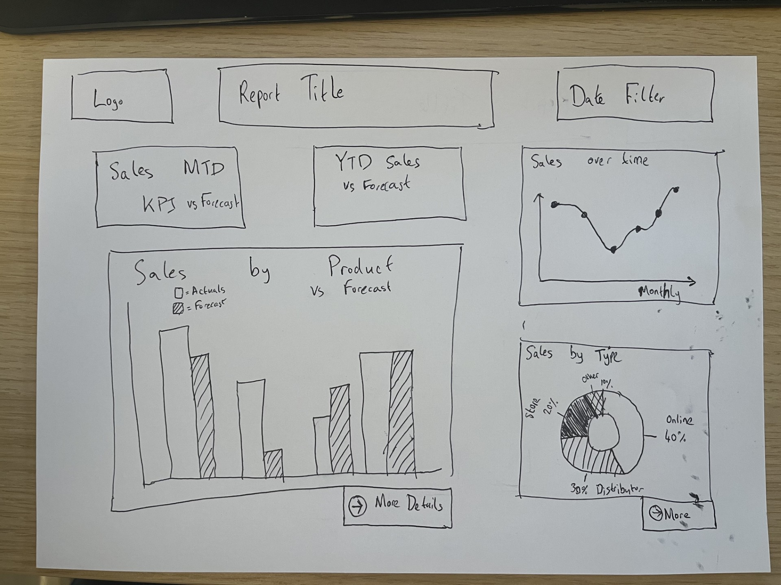
Wire Framing
Tip 1
Before jumping into PowerBI desktop to build a new report, you should create a wireframe design
Even if it’s just a quick 10 minute sketch, it makes the end product clearer and identifies likely user problems quicker
Share the sketch early – getting end users on board early helps in the long run
Even better if you can get your stakeholders to draw the wireframe for you! If they can’t then maybe the report scope isn’t clear enough yet!

Slide 3
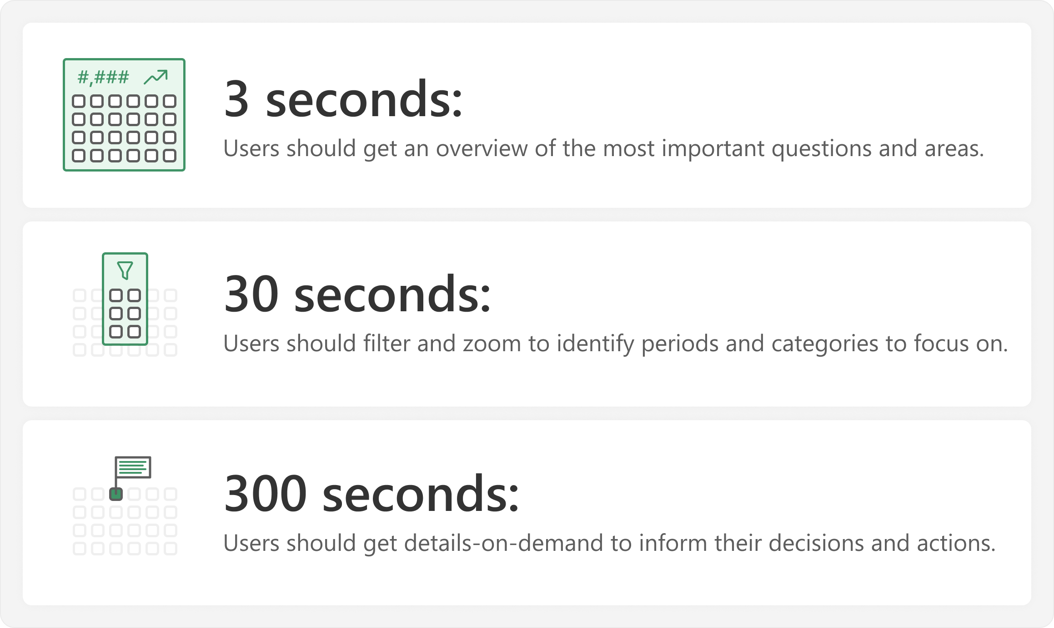

3 / 30 / 300 Rule
Concept is based on visual information-seeking mantra from Ben Schneidermann (1996)
SQLBI applied it to Report design in their article here:
Tip 2

Slide 4
Report 1
Bad Design

Slide 5
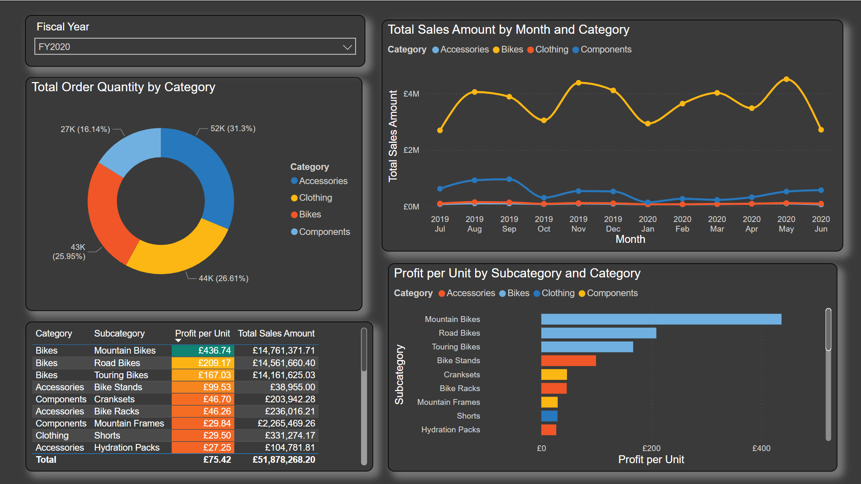

Slide 6
Report 2
Better Design

Slide 7
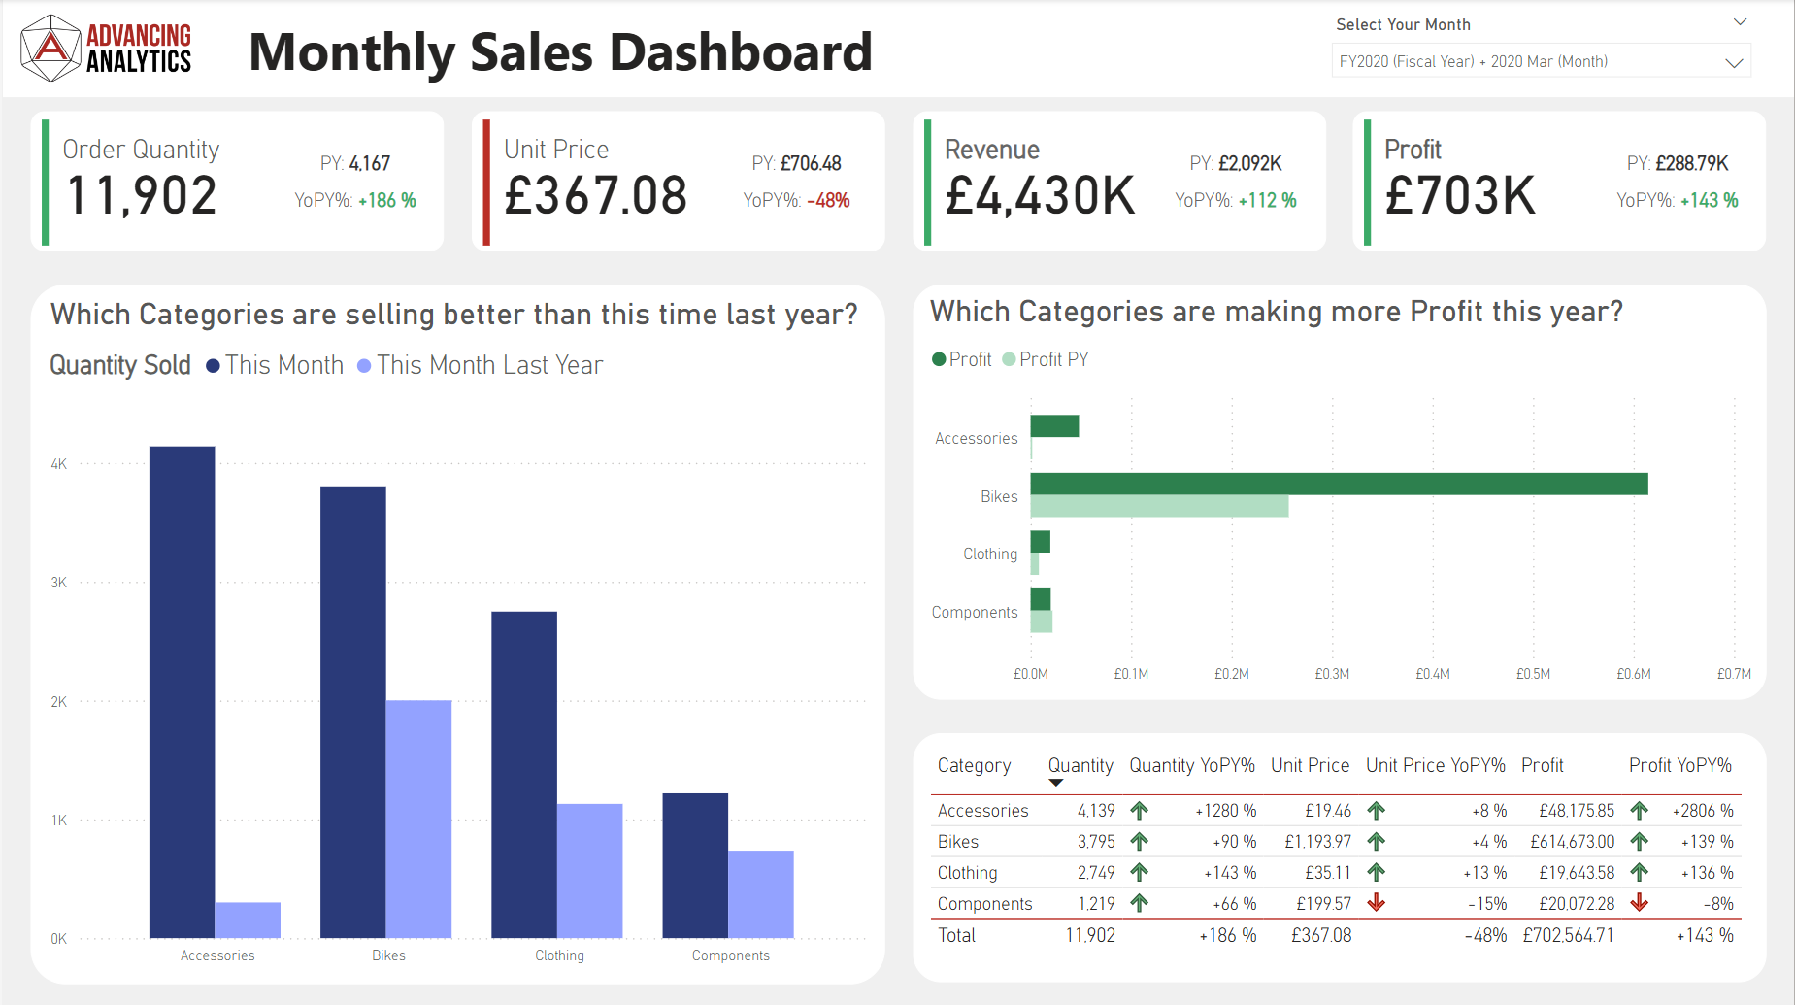

Slide 8
Hopefully, you can see how much more intuitive Report 2 is!
Make your end user’s life as simple as possible!

Slide 10

Tabular Editor
Tip 3
In my opinion, it’s the single biggest Power BI productivity boost out there
There is a free version Tabular Editor 2 & the paid for version Tabular Editor 3
TE2, has an array for features, including:
Batch measure editing
Best Practice Analyser
Advanced Data Modelling - OLS, Perspectives, Calculation Groups, Partitions, etc.
C# Scripting for Model changes
Model “Save to Folder” File Format
It’s now recommended by Microsoft as part of their DP-600 Fabric Analytics Engineering course

Slide 11



Workspace Git Integration
CI/CD in PowerBI
PBIP File Formats
Deployment Pipelines
Link your fabric workspaces to a git repository and gain all the benefits of automated version control. Git helps you identify how, when and who changed files.
PBIP file format allows you to split out your PBIXs into a series of files. It gives a better experience with version control & enables multiple developers to work on one report
Deployment pipelines allow you to deploy reports & models through a chain of workspaces (e.g. Dev, Test and Prod). They help you ensure changes are deployed in a robust manner
Tip 4

Slide 12

Atomic Design
Read the SQLBI article on Atomic Design:
Theme Templates
Backgrounds
Visuals
Investing time in creating a theme file
Themes are more than just a colour palette
You can set defaults for nearly every formatting option down to a per visual type level
I have a series of static PNG report backgrounds I can load into a report page to give instant structure
It saves time and creates more consistent layouts
I keep a template report file full of visuals and report items I might want to re-use
I can quickly copy and paste pre-formatted visuals into new reports
It’s especially handy with cards!
Tip 5

Slide 13
Atomic Design
Read the SQLBI article on Atomic Design:
Theme Templates
Backgrounds
Visuals
It’s really important to align these
across all the developers in your organisation
Consistent design pays dividends in user understanding
Investing time in creating a theme file pays dividends
Themes are more than just a colour palette
You can set defaults for nearly every formatting option at a per visual type
I have a series of static PNG report backgrounds I can load into a report page to give instant structure
It saves time and creates more consistent reports
I keep a template report file full of visuals and report items I might want to re-use
I can quickly copy and paste pre-formatted visuals into new reports
It’s especially handy with cards and icons!
Tip 5

Slide 14
Data Ink Ratio
Tip 6
Originally by Tuft, this advice says that you should maximise the amount of “data ink” compared to “non-data” ink
To do this, remove unnecessary elements wherever possible. For example, you should avoid:
Gridlines on bar charts
Data labels that repeat information already available in the visual
Colours that don’t have a purpose
This reduces visual clutter and makes your reports / visuals easier to digest

Slide 15
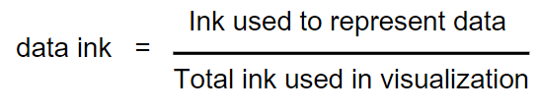
Tip 6
Data Ink Ratio
Originally by Tufte, this advice says that you should maximise the amount of “data ink” compared to “non-data” ink
To maximse your data-ink ratio, remove unnecessary elements wherever possible. For example, you should avoid:
Gridlines on bar charts
Data labels that repeat information already available in the visual
Colours that don’t have a purpose
This reduces visual clutter and makes your reports / visuals easier to digest

Slide 17

Questions as Visual Titles
Tip 7
The default visual titles are based on what fields a chart uses, e.g. “Total Sales Quantity by Fiscal Month by Product Category”
Flip chart titles to telling users what questions the chart can answer
E.g. “Which product categories are selling the most units?”
This makes it quicker for the user to understand & helps them take the right story away from your report

Slide 18
Take design inspiration from everywhere
LinkedIn Stars
Mobile Apps
Media
There are design superstars you can follow – my favourites:
Injae Park
Elena Drakulevska
Kerry Kolosko
Nick Lea-Trengrouse
And many, many others!
People intuitively know how to use mobile apps
What can you learn from them?
Navigation
Hero visuals
Cohesive design
If something in media resonates with you, think about why
E.g. Video games have massive design teams & can teach about:
Framing
Story-telling
Etc.
Tip 8
Design inspiration is everywhere, if you look for it!

Slide 19
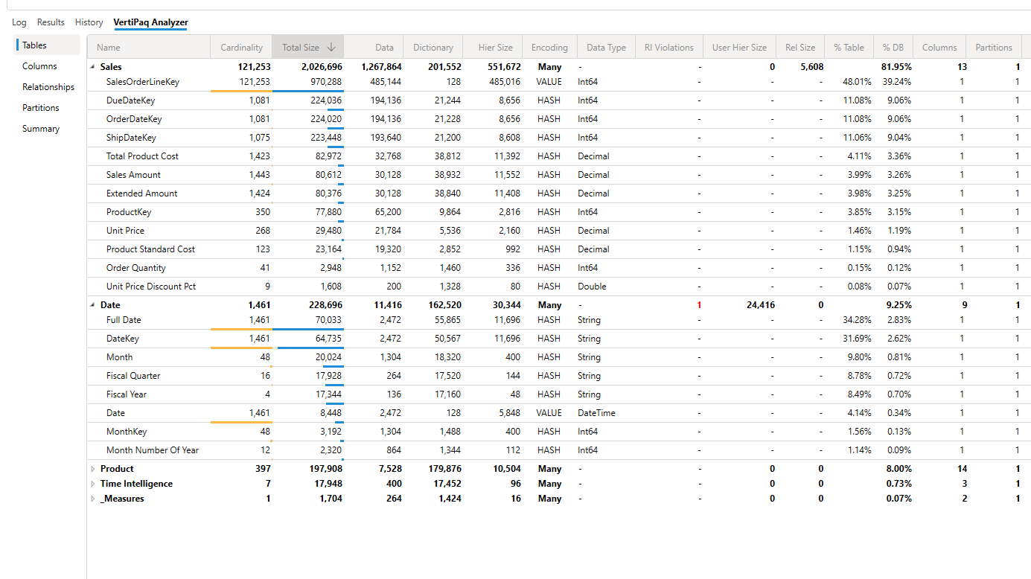
VertiPAQ Analyser
VertiPAQ Analyser is built into DAX Studio & Tabular Editor 3
It scans a semantic model and identifies fields which have an impact on model size
This lets you spot fields that are likely to cause performance issue
Removing or optimising these fields will make your reports / models run faster!
Tip 9

Slide 20
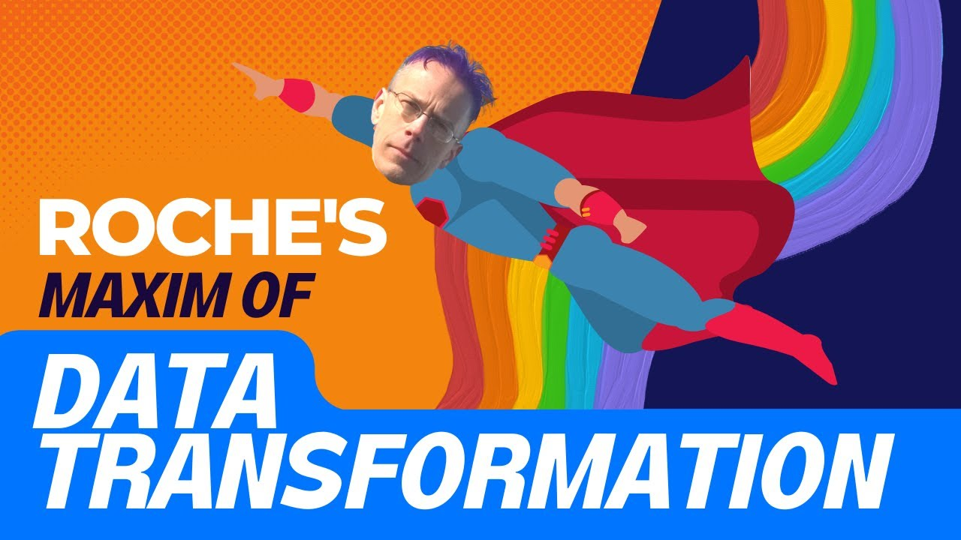
Roche’s Maxim
Tip 10
“Data should be transformed as far upstream as possible, and as far downstream as necessary”
The idea of the maxim is that you should avoid writing complex DAX or even M if you could instead build it upstream in your source system
Following the maxim will make models more performant and push compute into more optimised engines & avoids duplication (build it once in your warehouse rather than in all your reports / models)
The downstream as necessary covers scenarios where you don’t have access to change upstream systems, or you need a specific element to be “slice and dice”-able

Slide 21


Thank you for listening
Wireframing
3 / 30 / 300
Tabular Editor
CI / CD
Atomic Design
Data Ink
Questions as Visual Titles
Take design inspiration from everywhere
VertiPAQ Analyser
Roche’s Maxim
/aw2571

Slide 22
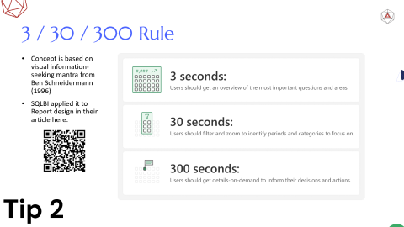
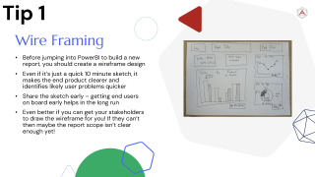
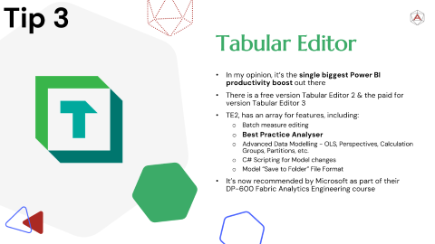
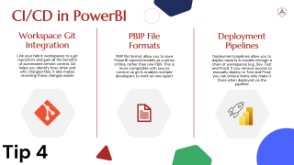
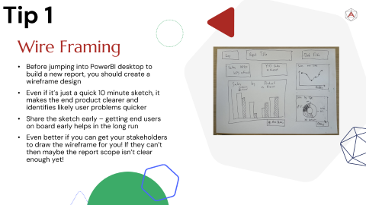
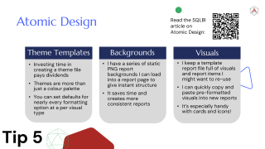



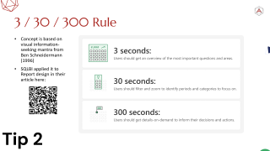
Thank you for listening!
Wire Framing
3 / 30 / 300 Rule
Tabular Editor
Learn to how to do CI/CD in Power BI
Take design inspiration from everywhere
1
2
3
4
5

